Slide 1
TECHNOLOGY AS A CORE
STRENGTH OF NATION

Slide 2
GROUP MEMBERS :
ABDUL BASIT (20K-0333)
MOHAMMAD YASIR JAMAL (20K-0158)
MUHAMMAD WARZAN (20K-1649)
MUHAMMAD AWWAB (20K-1615)
MUHAMMAD ANAS (20K-1726)

Slide 3
INTRODUCTION

Slide 4

MEANING AND DEFINITION
The word “Technology” derived from the Greek word “Techne”
Techne : Art , Skill , Craft .
It is the application of scientific knowledge to the practical aims of human life or ,
as it is sometimes phrased , to the change and manipulation of human environment
The branch of knowledge that deals with the creation and use of technical means and
their inter-relation with life society and environment

Slide 5

LIFE WITHOUT TECHNOLOGY
It is hard to imagine life before technology
What if you had to get through a day without the internet ?
What about going on a road trip without Google Maps ?
Life without technology would absolutely suck!
Due to the advent of technology ,the everyday life of people
has undergone a drastic change . Life , in the present times, has
become so much more comfortable ,easy, dynamic and fast.

Slide 6
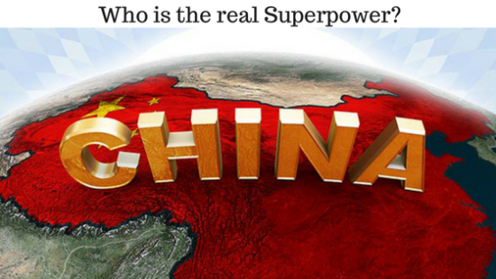
CHINA AS AN EMERGING SUPER POWER
Science and Technology in China have developed rapidly during the 1990s to 2010s.
The Chinese Government has placed emphasis through funding reform and societal status on
science and technology as a fundamental part of the socio-economic development of the
country as well as for the national prestige.
China has made rapid advances in areas such as education , infrastructure , high-tech
manufacturing , academic publishing , patents , and commercial applications and is now in
some areas and by some measures a world leader and an Emerging Super Power.

Slide 7
IMPORTANCE OF TECHNOLOGY
IN DIFFERENT ASPECTS OF LIFE

Slide 8

TECHNOLOGY IN HEALTHCARE
In everyday life
Diagnosis and treatment possible at home
e.g. smart watches to monitor heartbeat, apparatus for blood pressure, medicine
Professional healthcare
Advanced technology used to treat life threatening conditions
e.g. COVID patients in ICU
Information and awareness
If not for modern technology, most people wouldn’t be
aware of COVID-19 and it’s effects
Coordination of various doctors across the globe

Slide 9

TECHNOLOGY IN EDUCATION
Resources Available Online
e.g. Khan academy, Stack overflow
Online Platforms for Classes
e.g. Zoom, Google Meet
It has Become a Necessity for Learning
e.g. CS students need laptops/computers for
coding

Slide 10
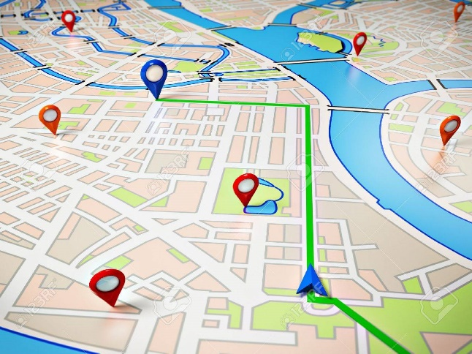

TECHNOLOGY IN TRANSPORTATION
Ease of Travel
Maps
GPS
Safer Travel
Development of better cars
Automated vehicles work faster to avoid accidents
Online Booking
Airplane, Train tickets
Uber, Careem

Slide 11

TECHNOLOGY IN COMMUNICATION
Text Messaging Services
In the earlier days, letters used to be written posted and took several time before reaching the recipient. But now these days texts enable you to send messages by the touch of a button at any corner of the world.
Social Networking Platforms
Through platforms such as Instagram, Facebook, Twitter among others users can communicate through comments, likes or even their profiles and status. This allow global communication.

Slide 12

Free Internet Calls
Through several social media sites free calls can be made without carrier charges by simply having an internet connection. Free internet calls are offered by sites such as WhatsApp or even Skype.

Slide 13
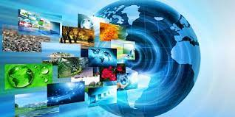
TECHNOLOGY IN ENTERTAINMENT
Technology and Entertainment Industry
Entertainment technology helps people not relax and enjoy some free/spare time.
Old ways such as recording on records, tapes, and CDs, have made music more accessible across the world. Movies, games are brought into living rooms through photography, film, and video. Many households are now having computers, consoles, or any other kinds of hand-holding computer game.
With digital streaming technology and availability of high-speed internet, there is an increase in the revenue of music and video.

Slide 14
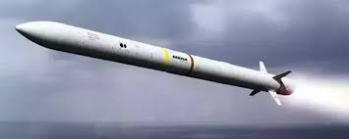
TECHNOLOGY IN DEFENCE
Military Defence Sector
It involves the military application of advanced scientific research regarding nuclear weapons, jet engines, ballistic and guided missiles, radar, biological warfare, and the use of electronics, computers and software.
It drives changes in warfare more than any other factor. Airplanes, missiles, tanks, drones, satellites, computers, GPS, and all the remaining panoply of the modern high technology battlefield would be incomprehensible to them.

Slide 15

TECHNOLOGY IN PROFESSIONS
There are a lot of benefits of technological breakthroughs and development,While our homes are now much smarter, it’s our workplace that has benefited the most. No matter what line of business you’re in, if you only look back to a decade or so ago, you’ll see how easier your life is now.
Improved collaboration
Access to information
Security

Slide 16
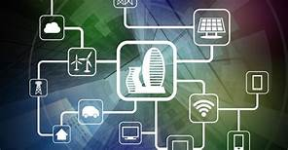
TECHNOLOGY IN INDUSTRIES
Advances in various technologies have helped a range of industries to move forward and embrace the Fourth Industrial Revolution
Big Data:
Big data is disrupting a lot of industries. Big data is helping industries to manage resources better and helping workers to complete tasks faster.
Virtual Reality:
Real estate industry
Fitness industry
Fashion retailers

Slide 17
TECHNOLOGY IN TRADE
International trade has dominated the global headlines recently. Innovative technologies in the Fourth Industrial Revolution are transforming trade by making the processes more inclusive and efficient.
Blockchain:
blockchain technology address global trade issues such as high costs and lack of transparency and security.
Artificial Intelligence:
Artificial Intelligence and Machine Learning can be used to optimize trade shipping routes, manage vessel and truck traffic at ports, and translate e-commerce search queries from one language into other languages and respond with translated inventory.

Slide 18

TECHNOLOGY IN BUSINESS
Improved Communication
It helps to connect and communicate with employees seamlessly.
Give instant feedback and suggestions through video conferencing e.g. Skype, Zoom, and Meet to grow business.

Slide 19

Improves Efficiency
It provides deal with customer queries by using chatbots technology for customer.
Drones are widely used in business to provide fastest services. Such as Amazon Shipping Service.
Streamlined Decision Making
With the help of great technology like AI, ML, Deep Learning and Big Data which gather data, process and improves user experience.
It helps to increase weak areas into strong zone.

Slide 20
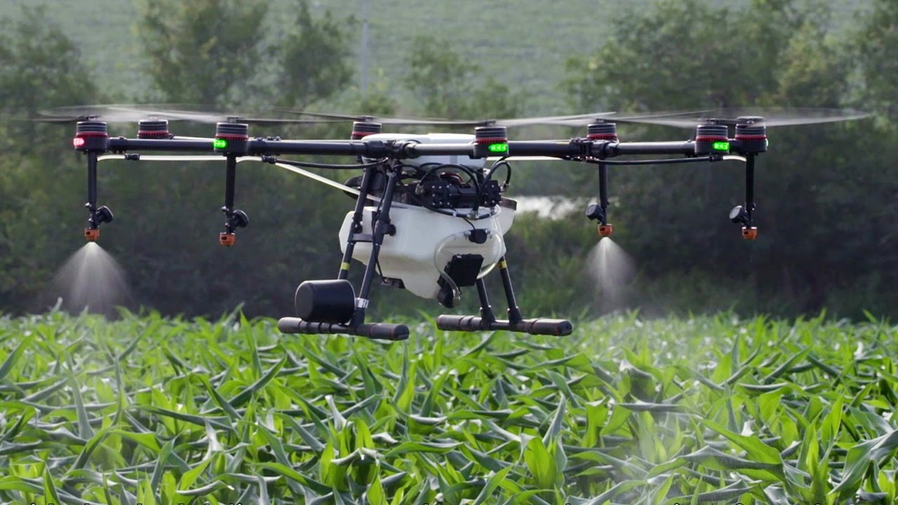
Technology in Natural resources
Improves Farming
Due to Technology, It predict the rainy seasons, storms, and other conditions.
Drones are also helps to take care of plants such as DJI AGRAS T20.
Remote Sensing of plants Physiology. It helps farmers to monitor the biological status of their plants and take decisions.

Slide 21

Technology in Energy resources
Energy Efficiency
Making energy from natural resources such as sunlight, wind, tides, rains etc.
Lots of Solar Panels are used to increase development of energy by reducing pollution on Earth.
High performance machinery’s are developed for mining of different types of natural resources and used for electricity.

Slide 22
QUOTATION OF THE DAY:
“With technology you can now be your own record company, director, producer, etc. If you have talent, you can display it on the Internet and the world will tell you their thoughts in the matter of seconds.”
Romeo Miller, Rapper

Slide 23


